Slide 1
ONLINE COURSE
Presented By
Md. Morshed Ali (B170305013)
Md. Ashraful Haque Tani (B170305007)

Slide 2
WHAT IS THIS!
1
This is a web base platform where we can purchase CSE related courses

Slide 3
OUTLINE
2
01.
OBJECTIVE
02.
MOTIVATION
03.
07.
FEATURES
LANGUAGE & TOOLS
04.
08.
USE CASE
SNAP SHOT OF WEB
05.
09.
DATABASE DESIGN
FUTURE WORK
06.
10.
ER DIAGRAM
REFERENCES

Slide 4
01
OBJECTIVE
3

Slide 5
OBJECTIVE
4
Learning abilities vary among individuals, yet schools teach them in one classroom. Managing learning abilities could be difficult.
This Online Course Management System integrates learning techniques which addresses this problem. The aim of this work therefore is to develop an adaptative e-Learning Software to enable the learner answer questions or solve problems based on his/her ability.

Slide 6
02
MOTIVATION
5

Slide 7
MOTIVATION
NEW STRATEGY
LIFETIME ACCESS
CONVENIENT LEARNING
6
The idea of this online course is taken from the idea of how to create skilled people by taking various skill acquisition courses sitting at home when people are confined to their house, school and college are completely closed for the sake of COVID-19.
To provide quality, and overall standard
Contents for students from village also
Student can access many time. Have a scope for practicing problems more times.
students can complete the course at their convenient time by completing the tutorial.

Slide 8
03
FEATURES
7

Slide 9


FEATURES
FRONTEND
BACKEND
8
Accessible by Users (Students)
Accessible by Admin (Owner of this platform)

Slide 10
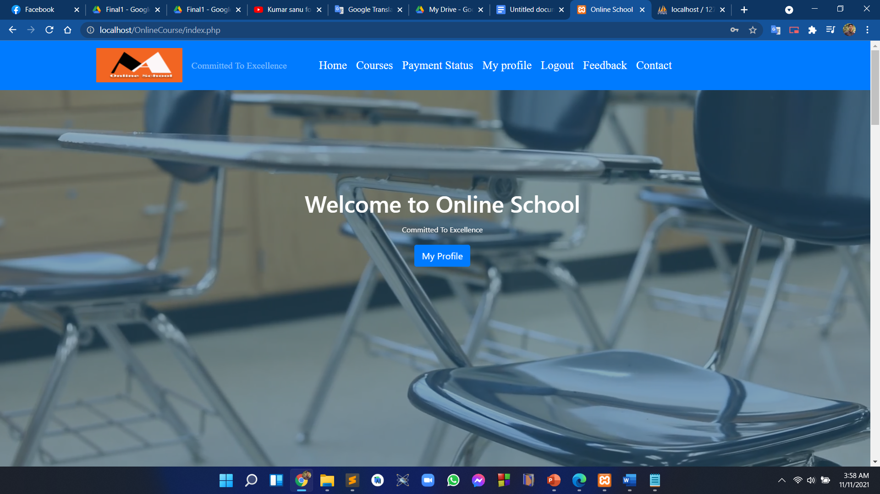
FRONTEND FEATURES!
9
Homepage
Courses
Login
Signup
Profile manage
Feedback
Contact

Slide 11
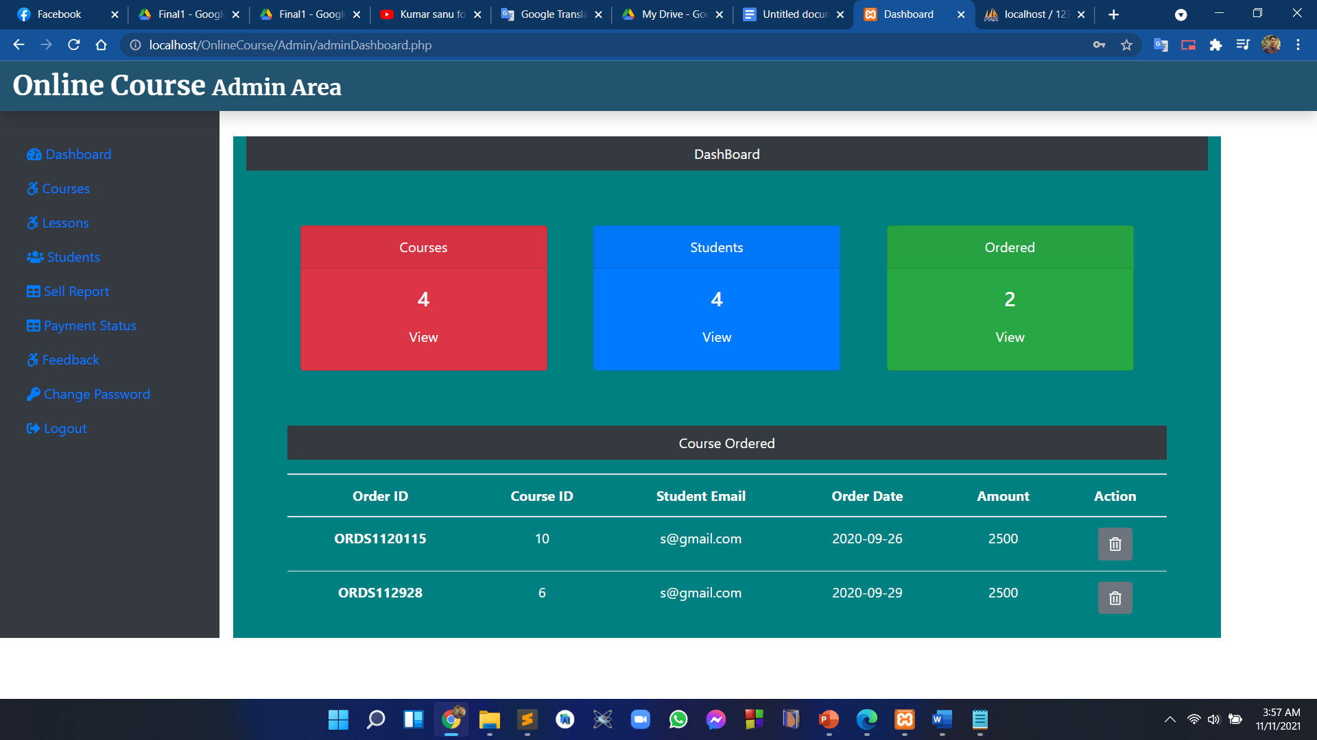
BACKEND FEATURES!
10
Dashboard
Manage Courses
Manage Lessons
Manage Students
Sell Reporting
Manage Feedback
Payment Status

Slide 12
04
USE CASE
11

Slide 13
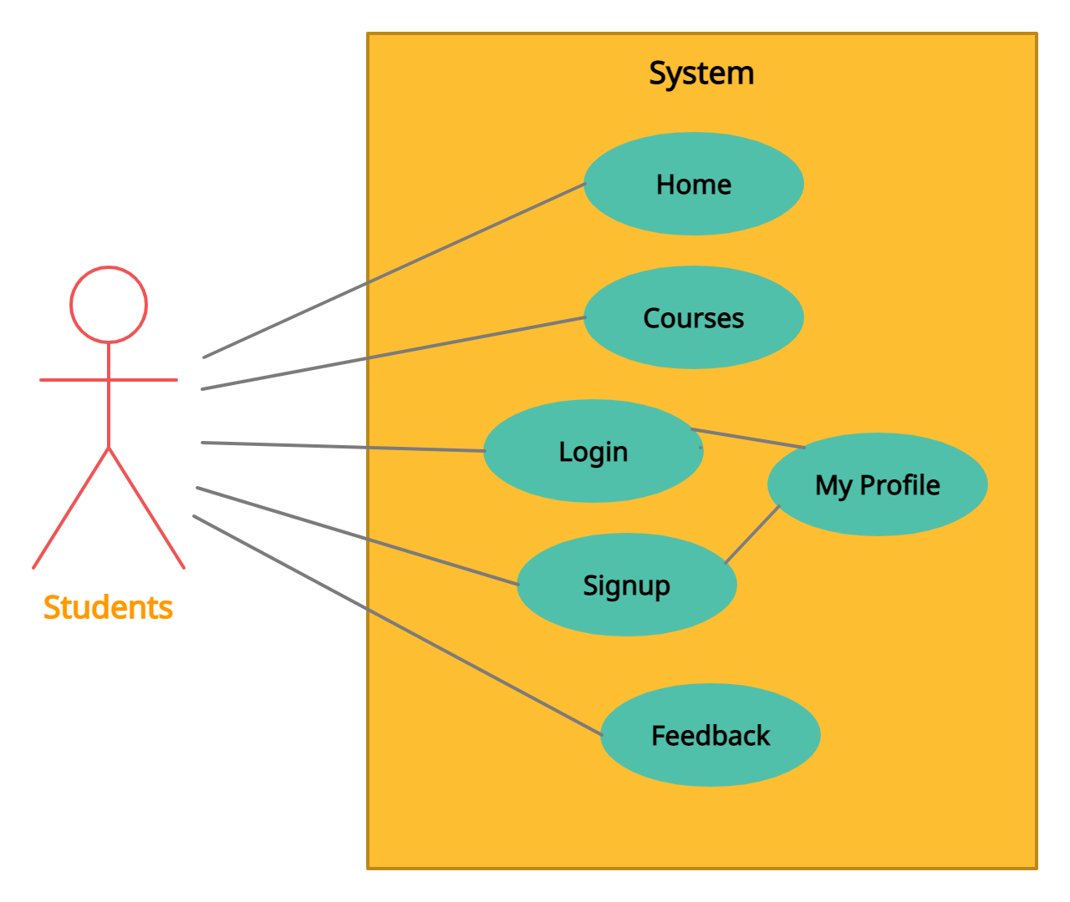
USE CASE DIAGRAM FOR STUDNTS!
12

Slide 14
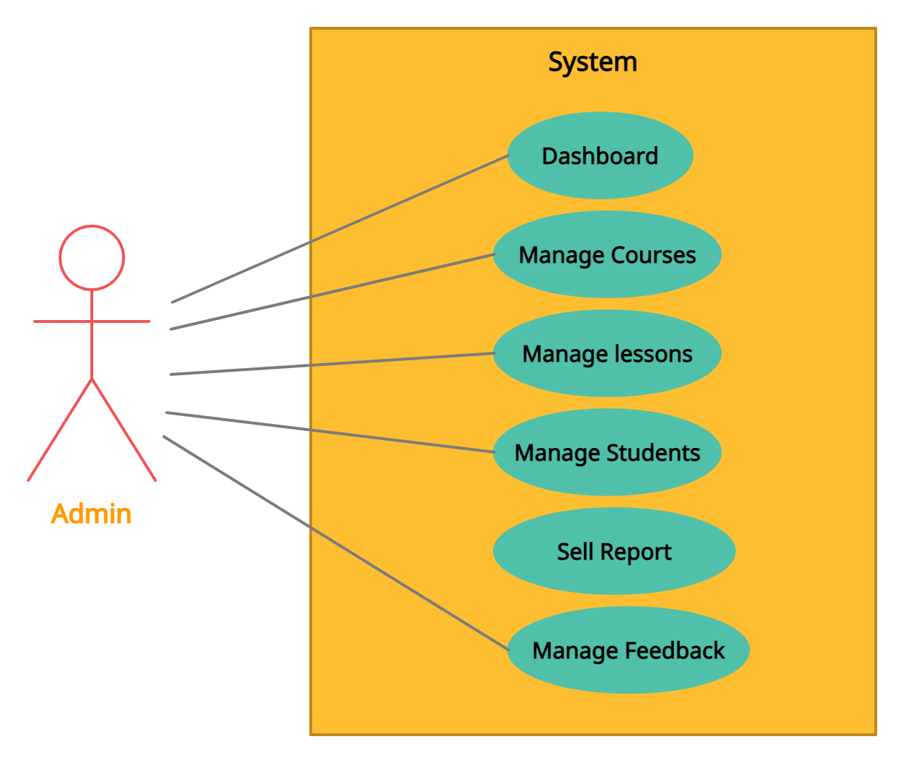
USE CASE DIAGRAM FOR ADMIN!
13

Slide 15
05
DATABASE DESIGN
14

Slide 16
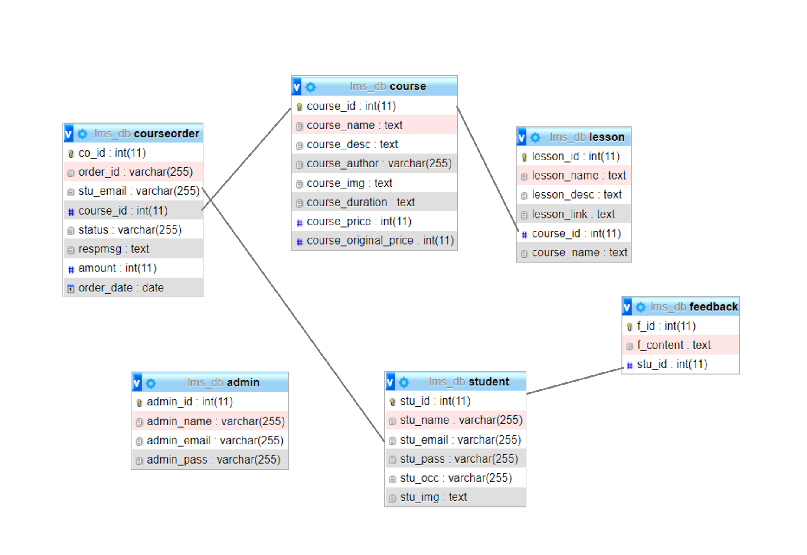
DESIGNER VIEW OF DATABASE
15

Slide 17
06
ER DIAGRAM
16

Slide 18
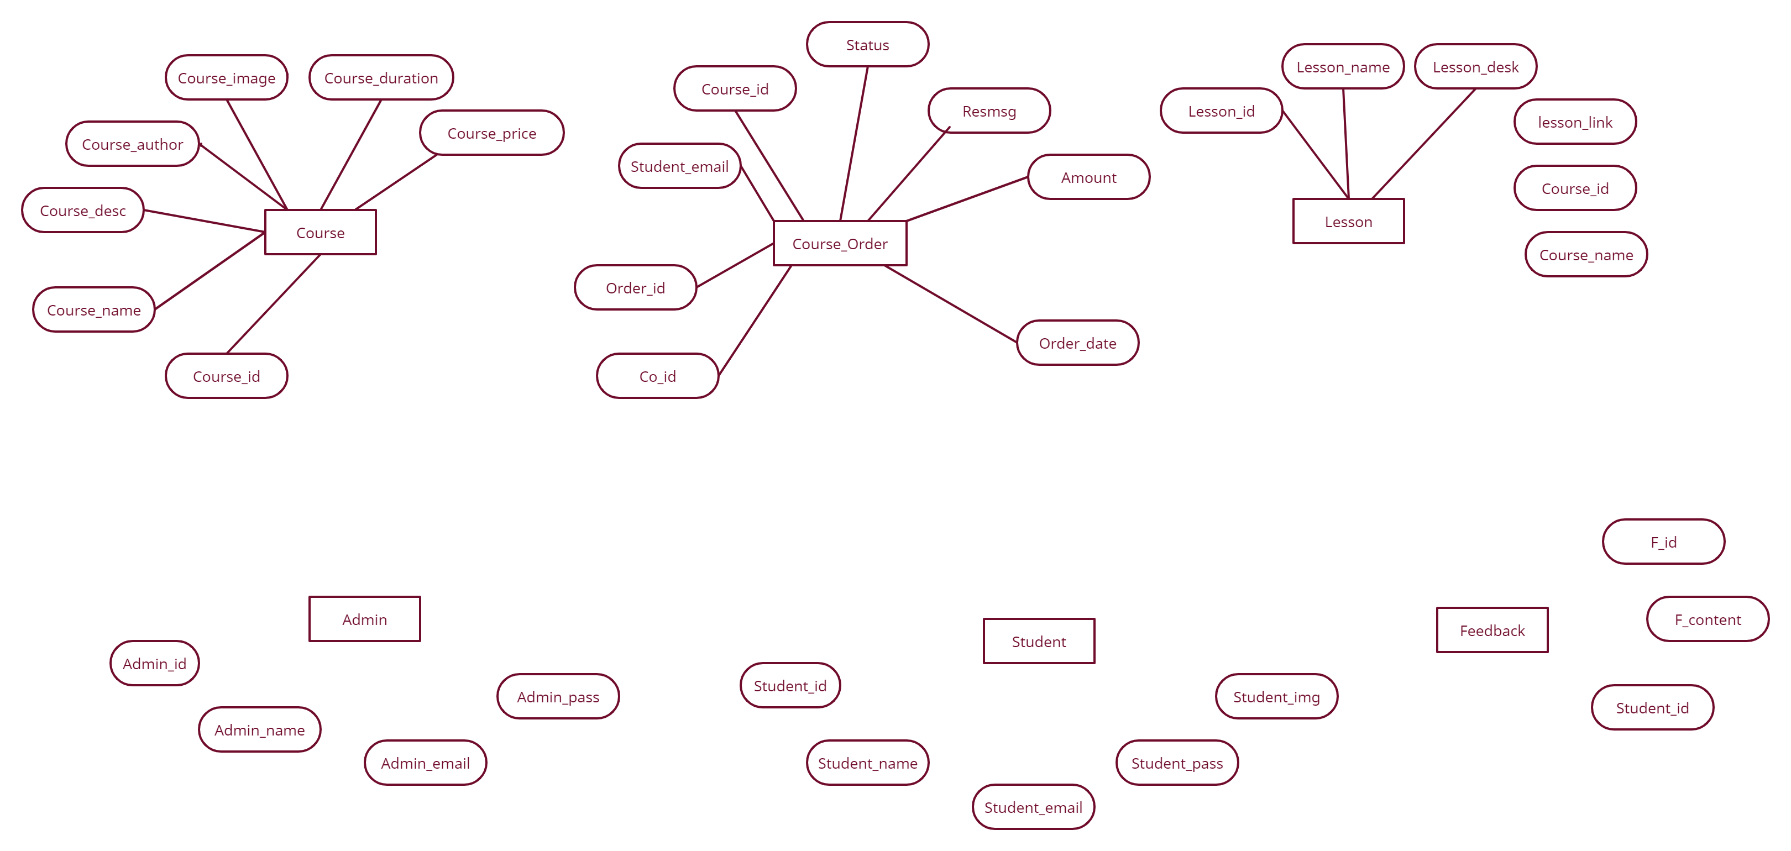
17
ER DIAGRAM

Slide 19
07
LANGUAGE & TOOLS
18

Slide 20
LANGUAGE & TOOLS
HTML
BOOTSTRAP
MYSQL
SUBLIME TEXT
19
CSS
JAVA SCRIPT
PHP
CHROME

Slide 21
08
SANPSHOT OF WEB (STUDENT)
20

Slide 22

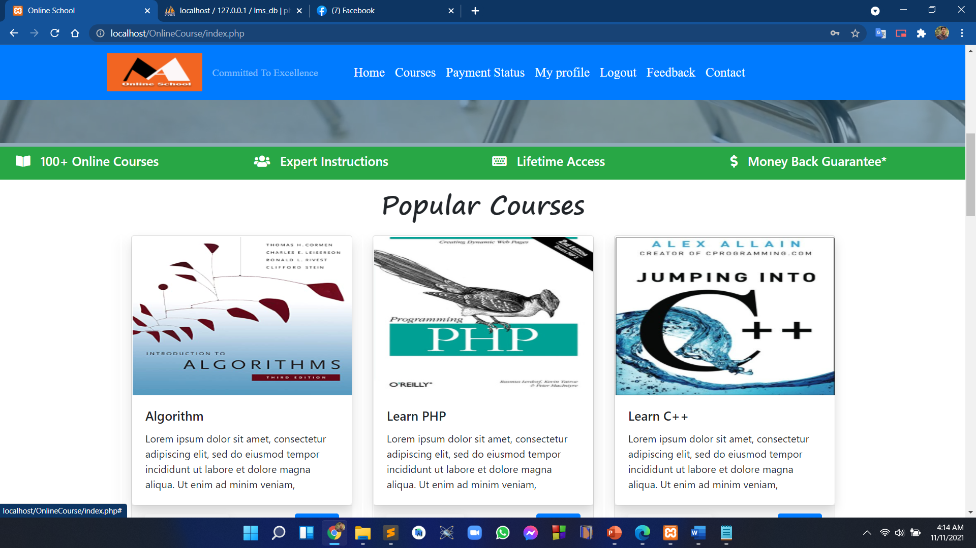
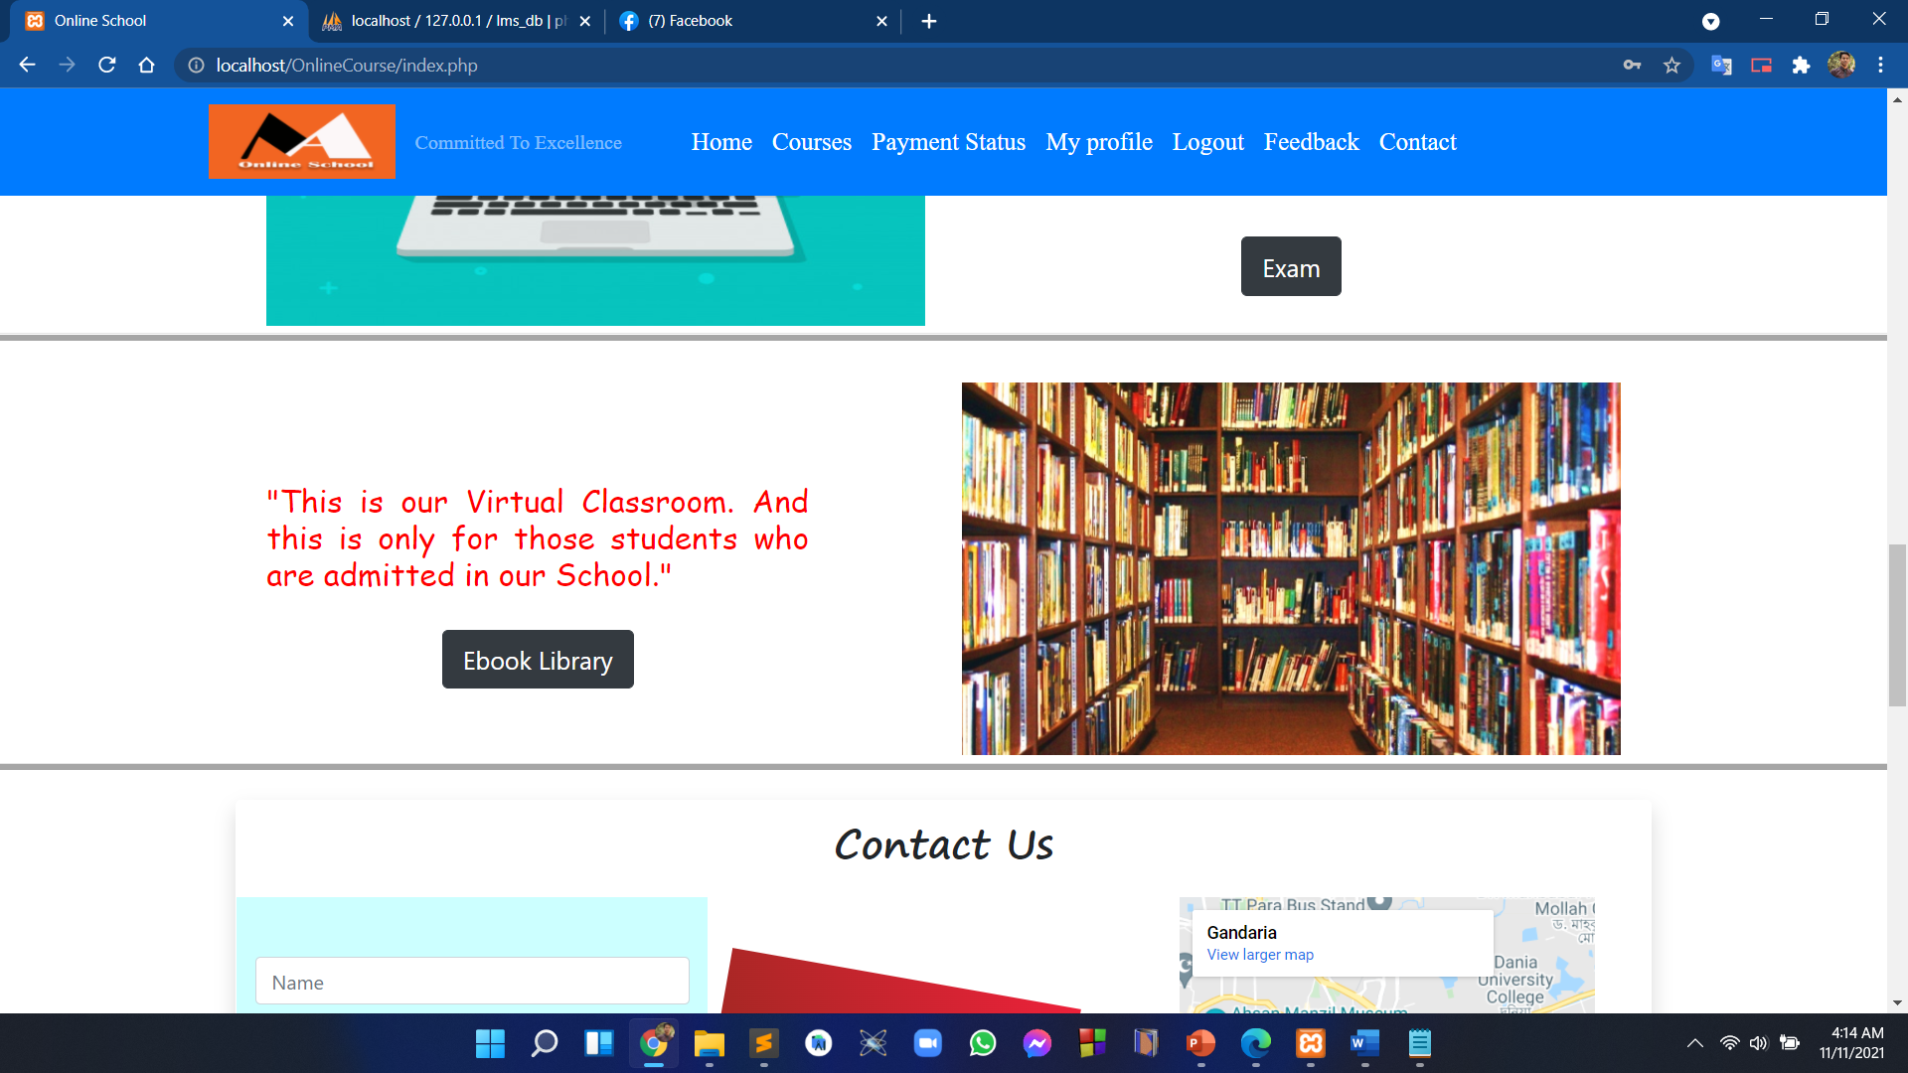
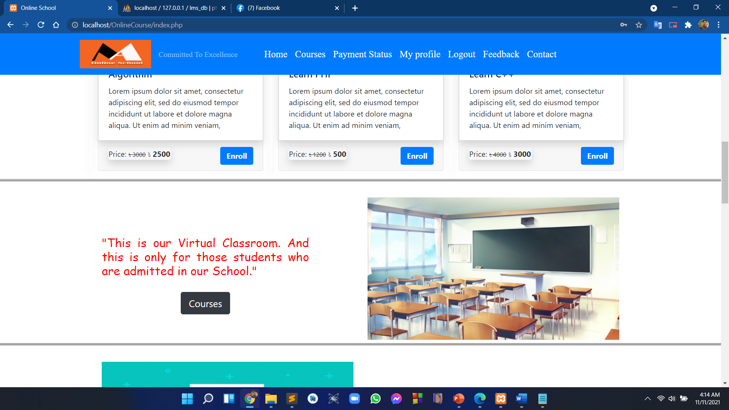
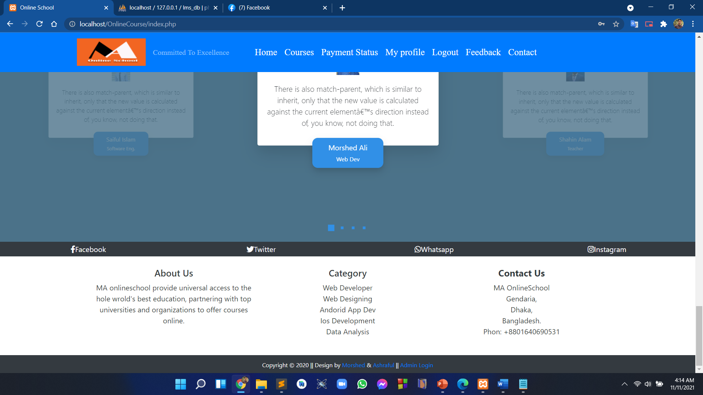
HOME PAGE
21

Slide 23
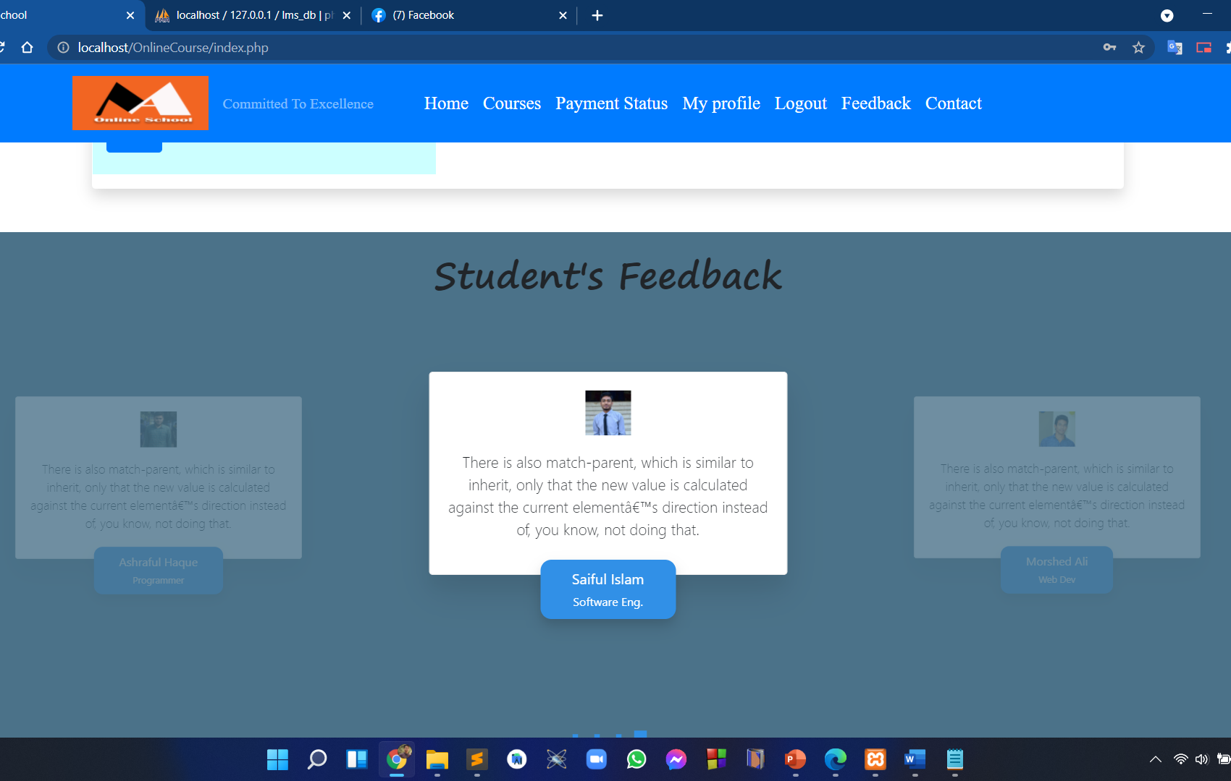
STUDENT FEEDBACK
22
This page shows all the feedback provided from students

Slide 24
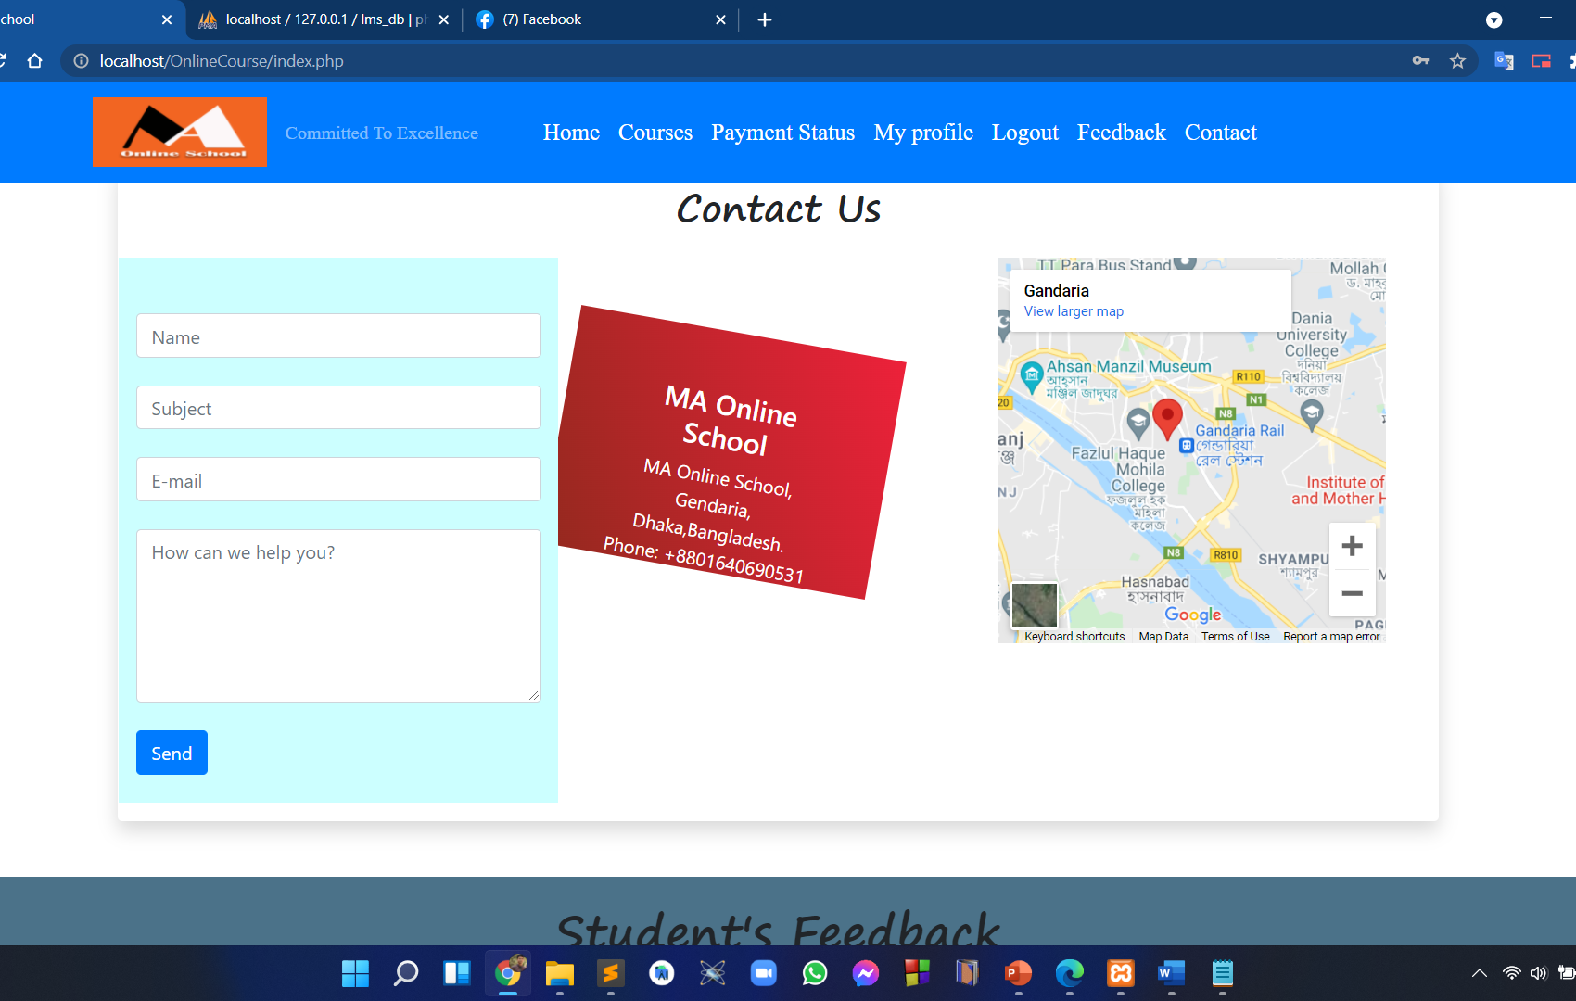
CONTACT PAGE
23
To contact with authority registered or non registered student can use this page.

Slide 25
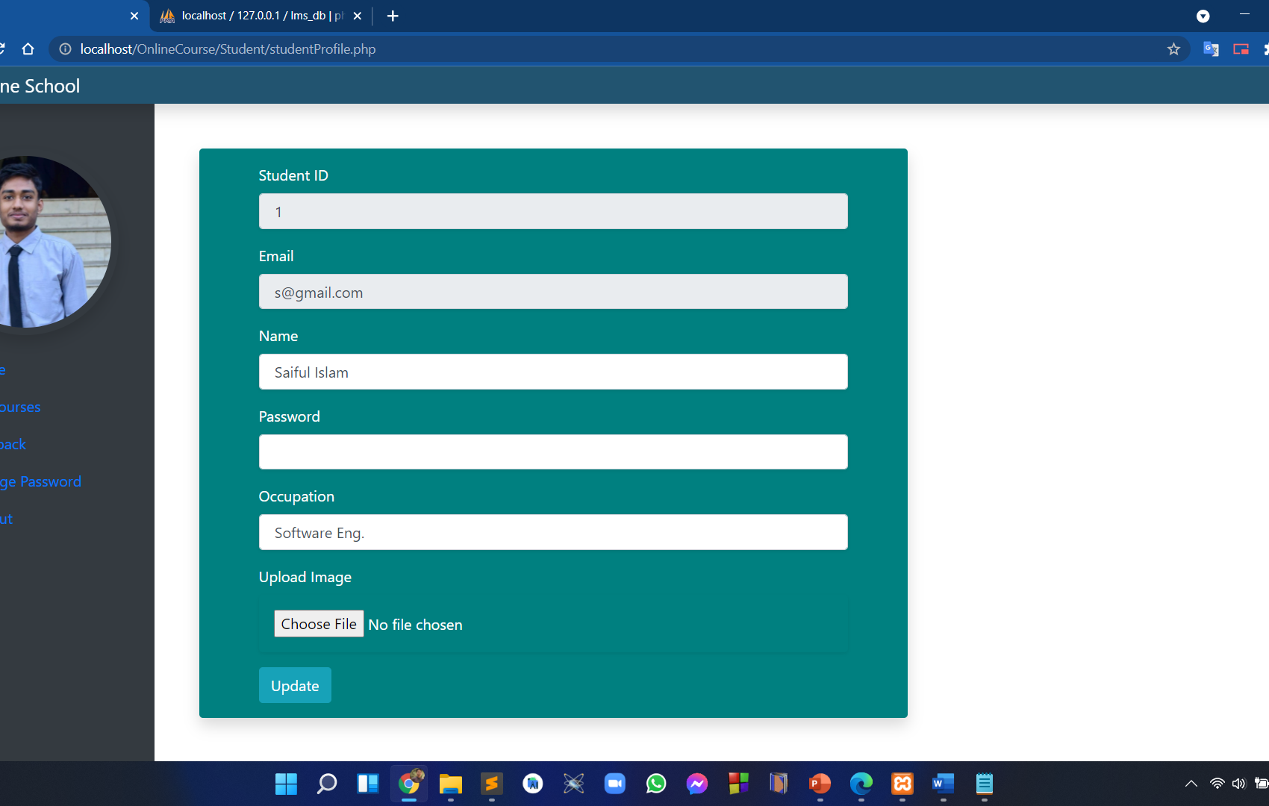
STUDENT PROFILE
24
Student can update his/her profile information.

Slide 26
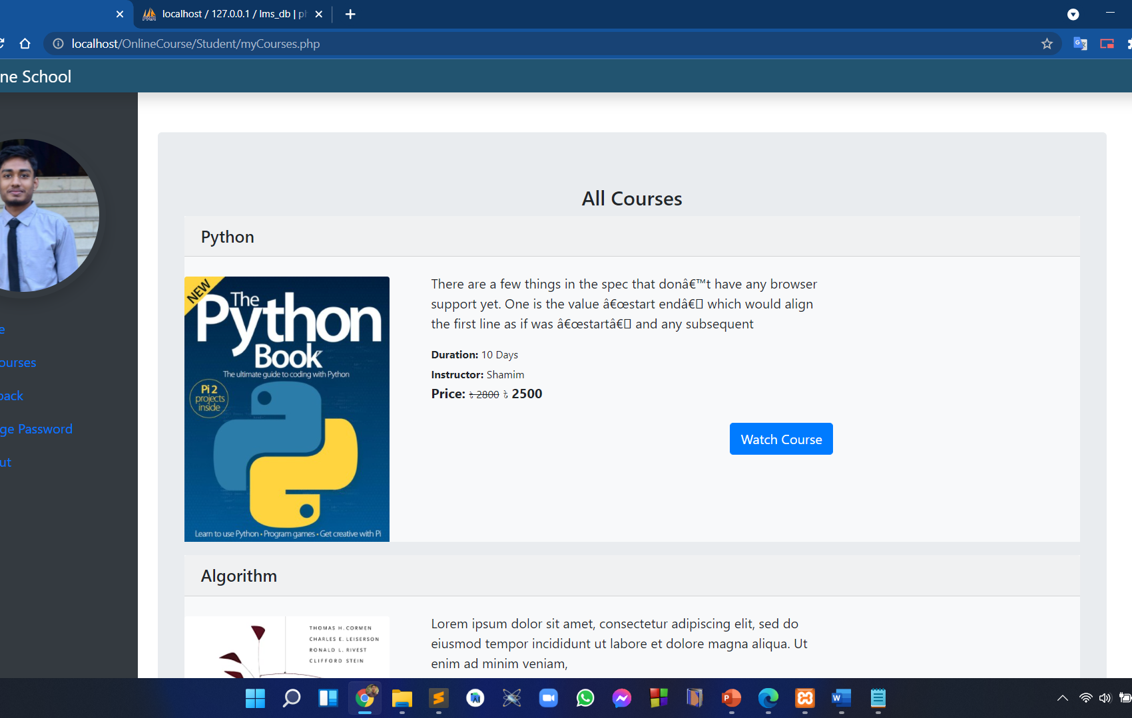
PURCHASED COURSE
25
After buying courses student can access those course inside his/her profile.

Slide 27
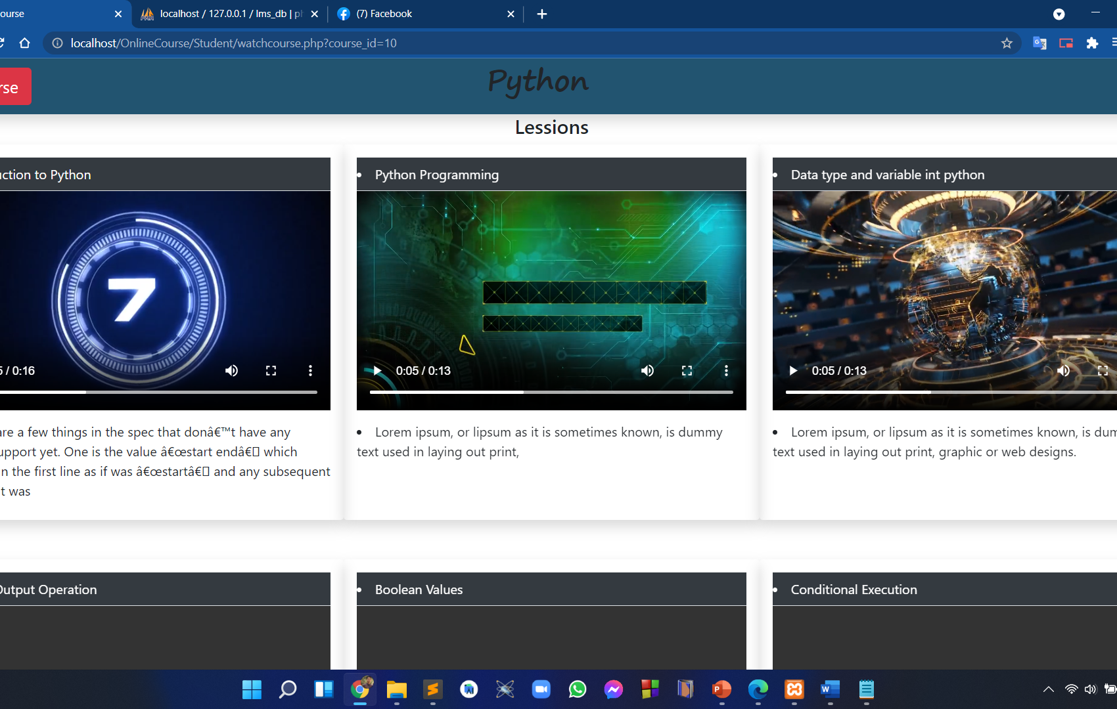
COURSE LESSON
26
All the lesson show after clicking watch course button.

Slide 28
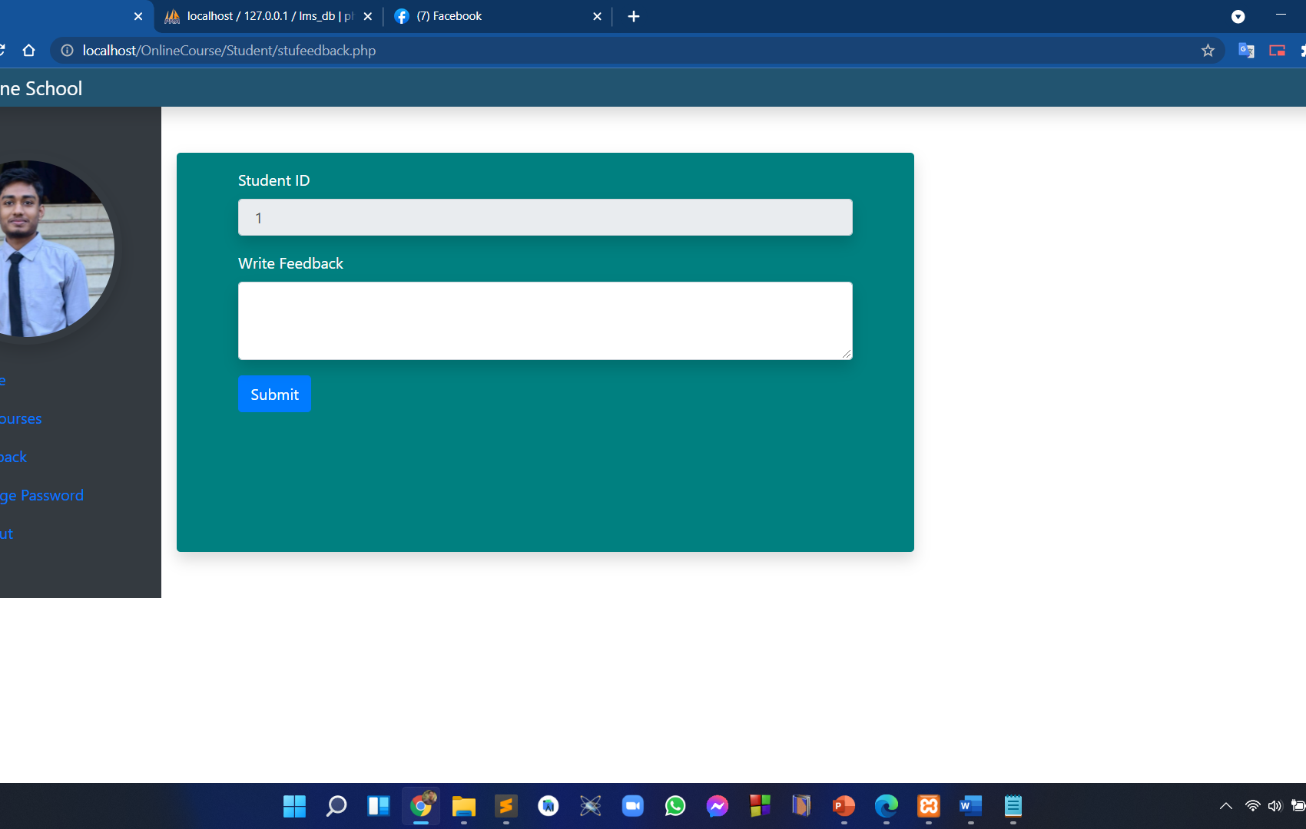
PROVIDE FEEDBACK
27
As a student he/she can provide a feedback which will show in the homepage feedback section.

Slide 29
08
SANPSHOT OF WEB (ADMIN)
28

Slide 30
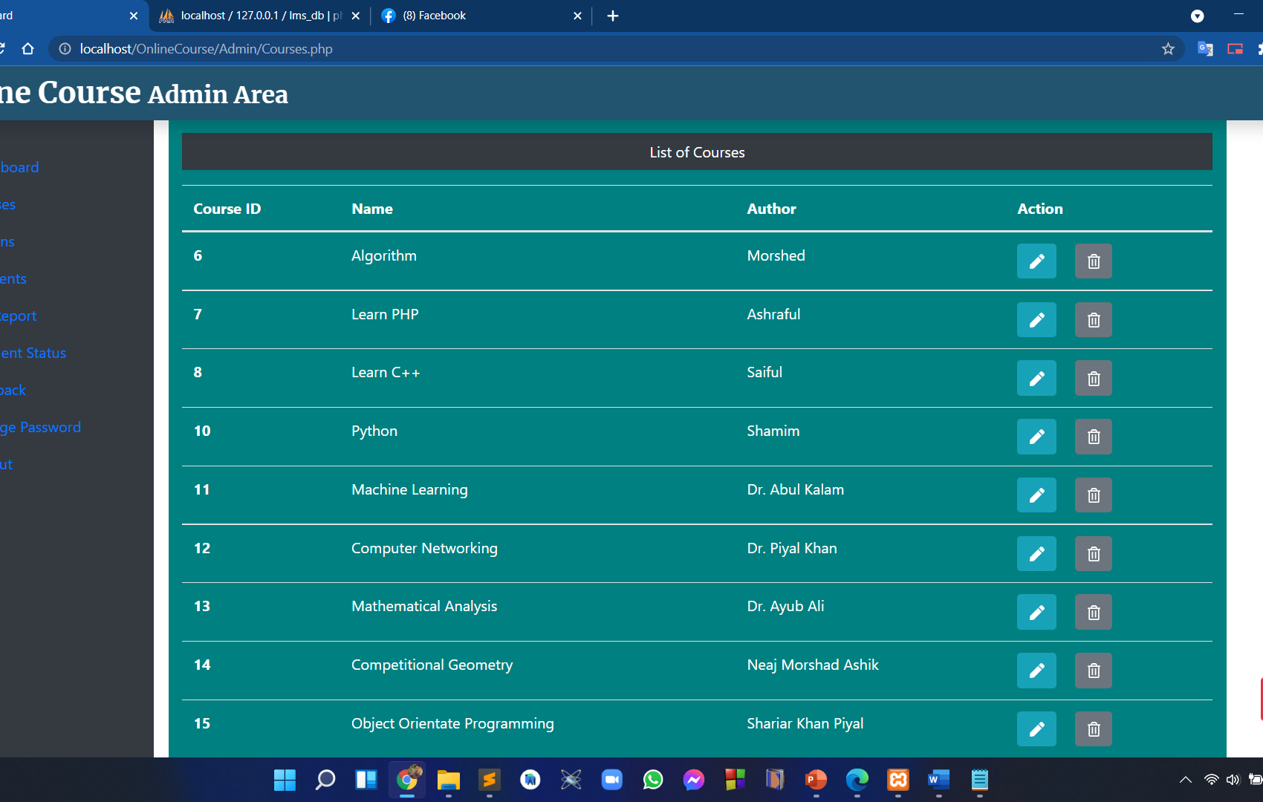
MANAGE COURSES
29
Admin can edit, delete and add any course.

Slide 31
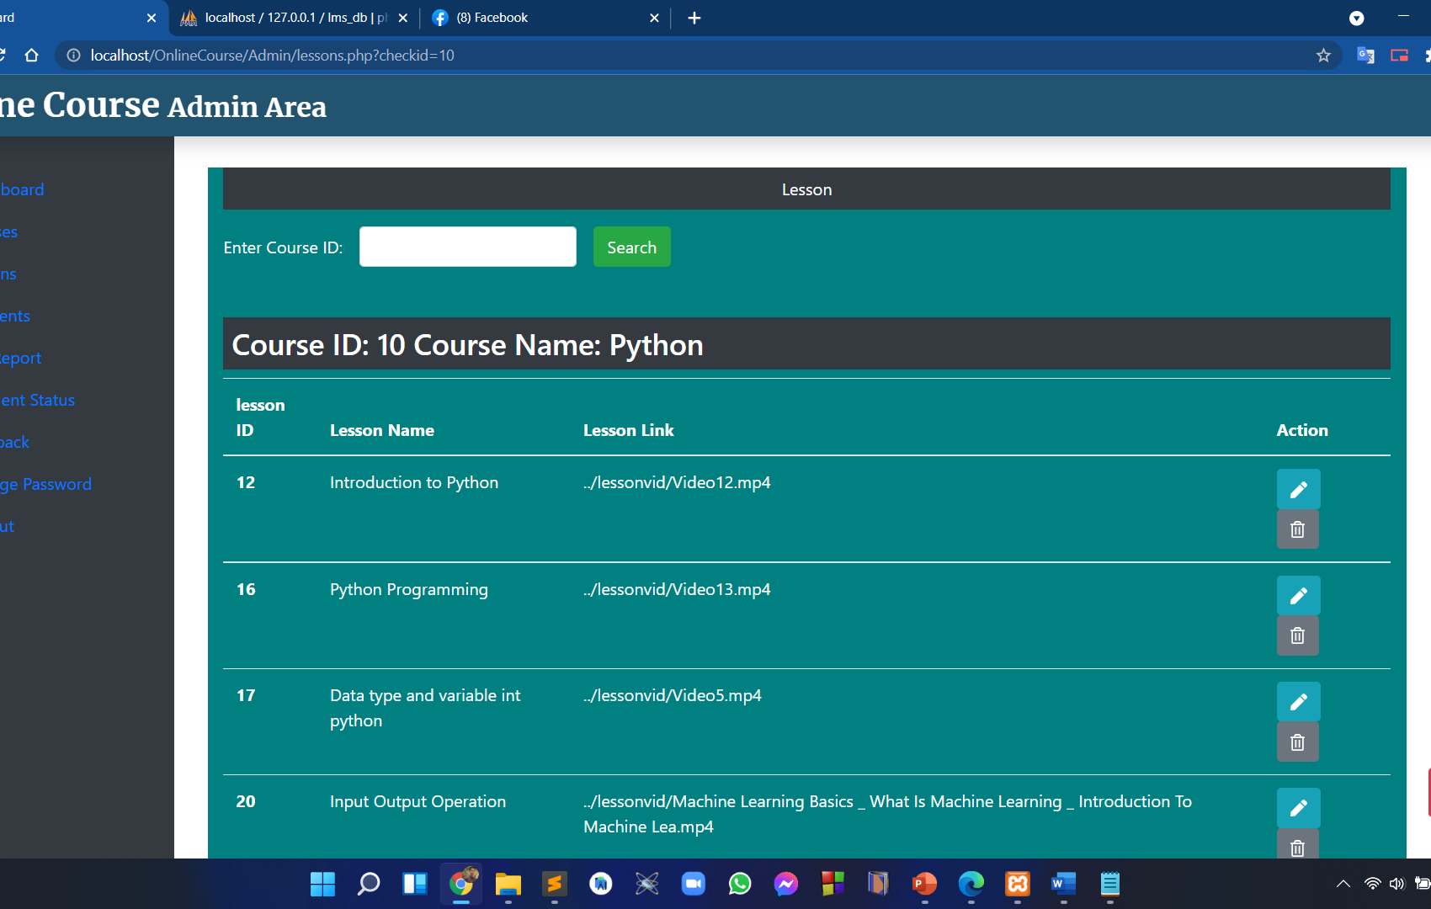
MANAGE LESSON
30
Admin can edit, delete and add any courses lesson after searching desired course id.

Slide 32
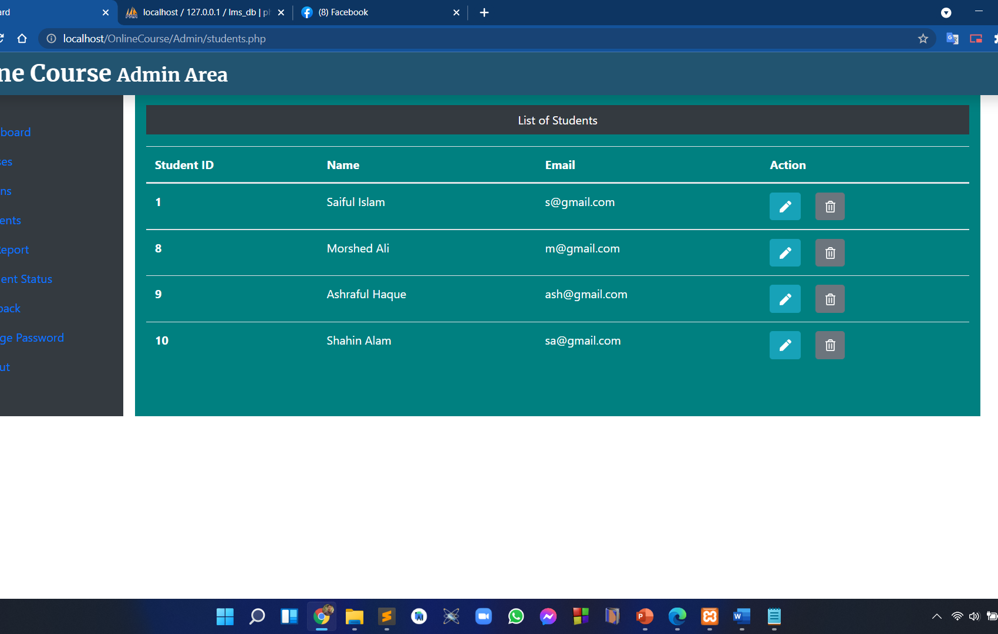
MANAGE STUDNET
31
Admin can edit, delete and add any student history/ profile.

Slide 33
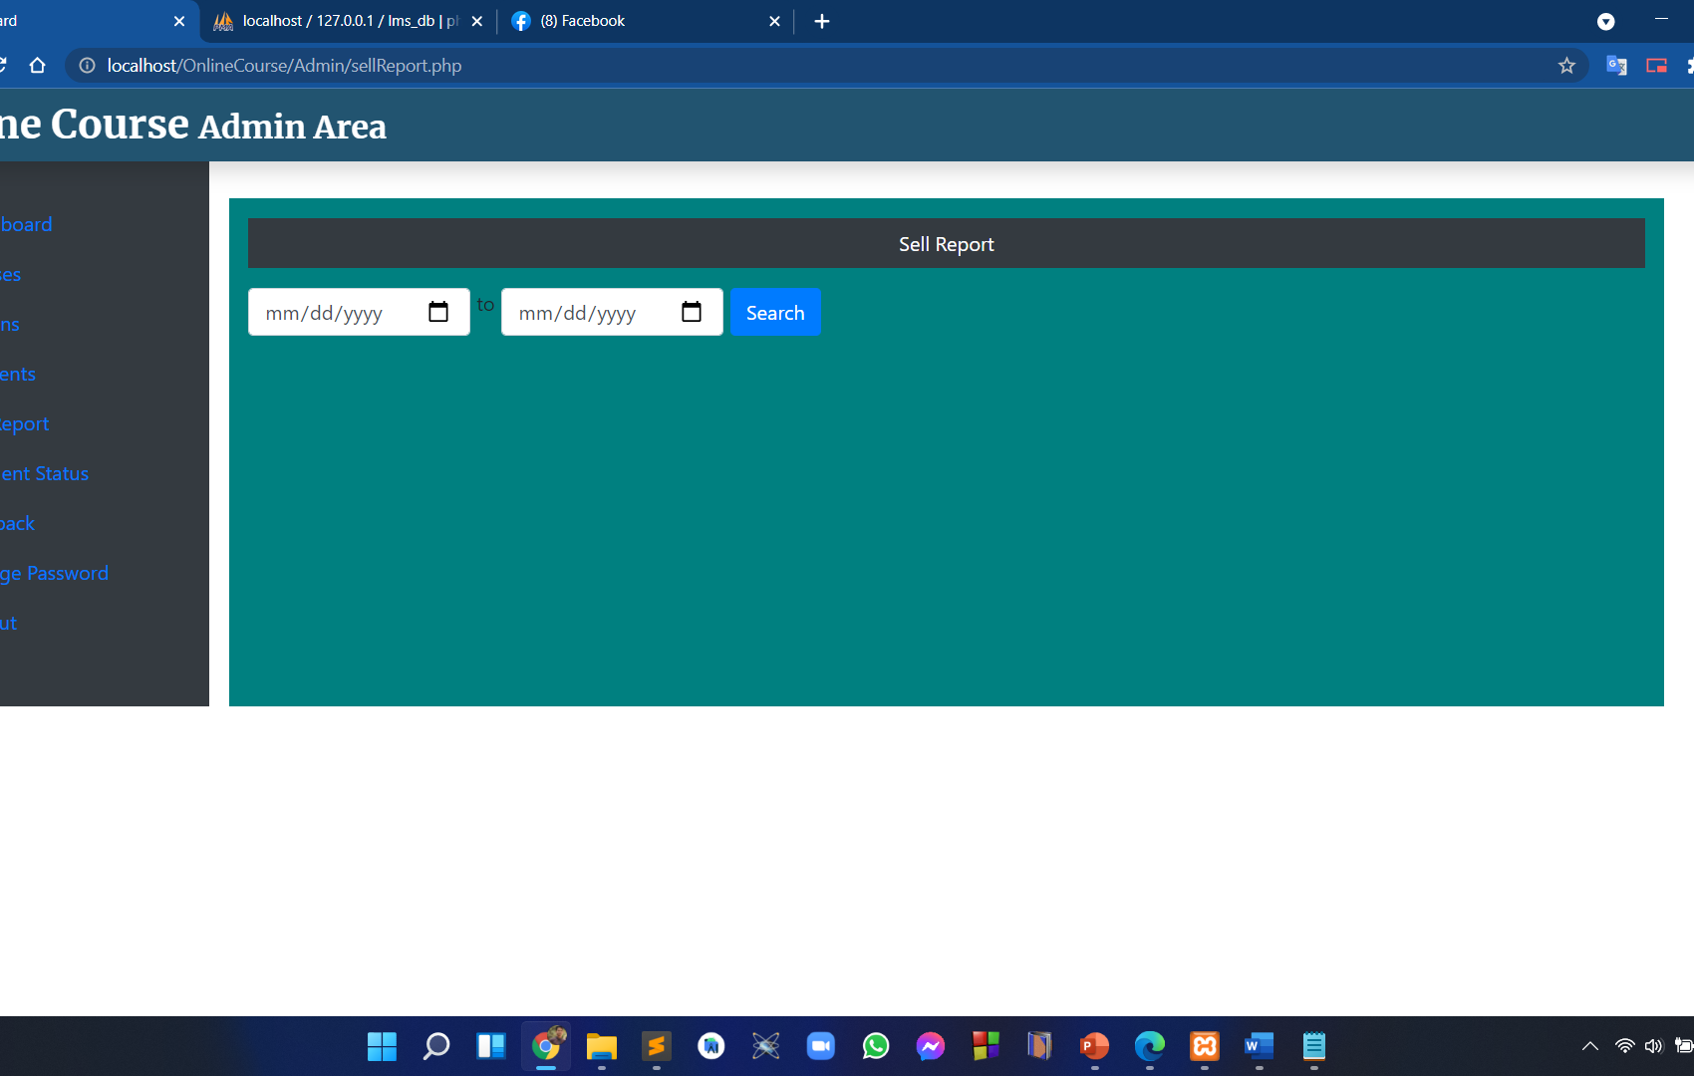
MANAGE SELL REPORT
32
Admin can easily create a sell report from one date to another date.

Slide 34
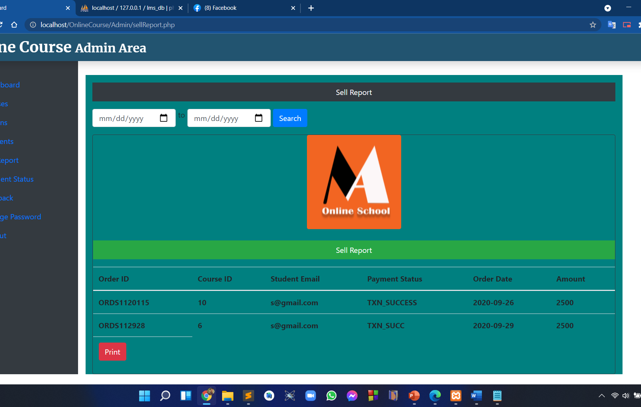
MANAGE SELL REPORT
33
This is a view of sell report.

Slide 35
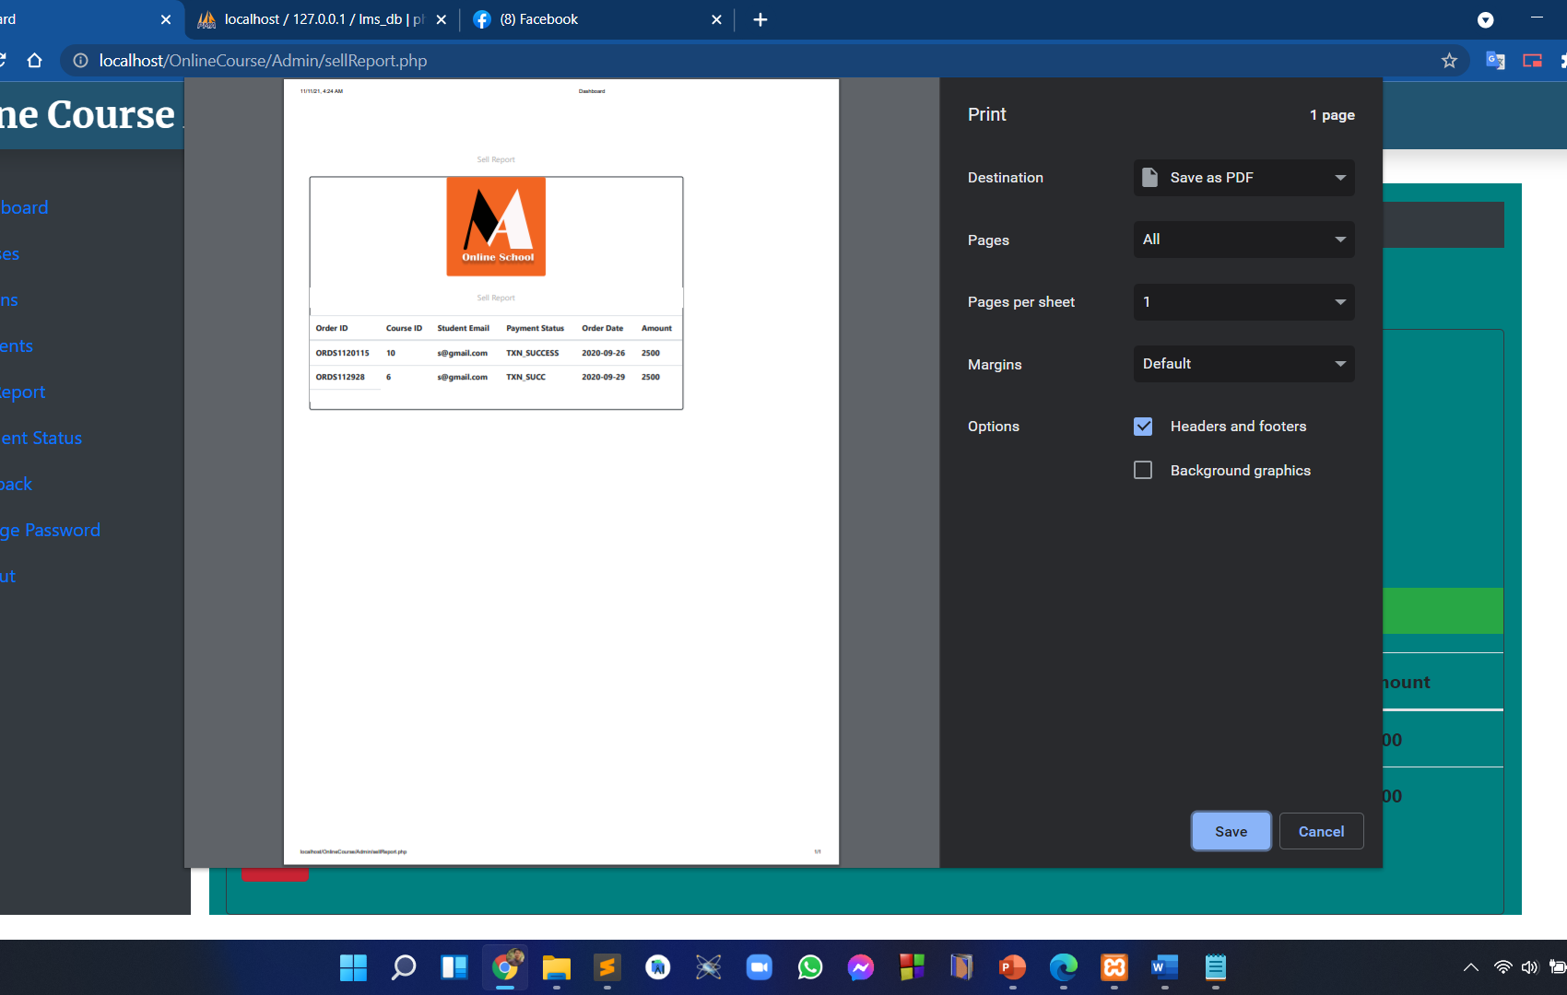
SELL REPORT
34
After clicking print sell report this pdf is auto generated and ready to download.

Slide 36
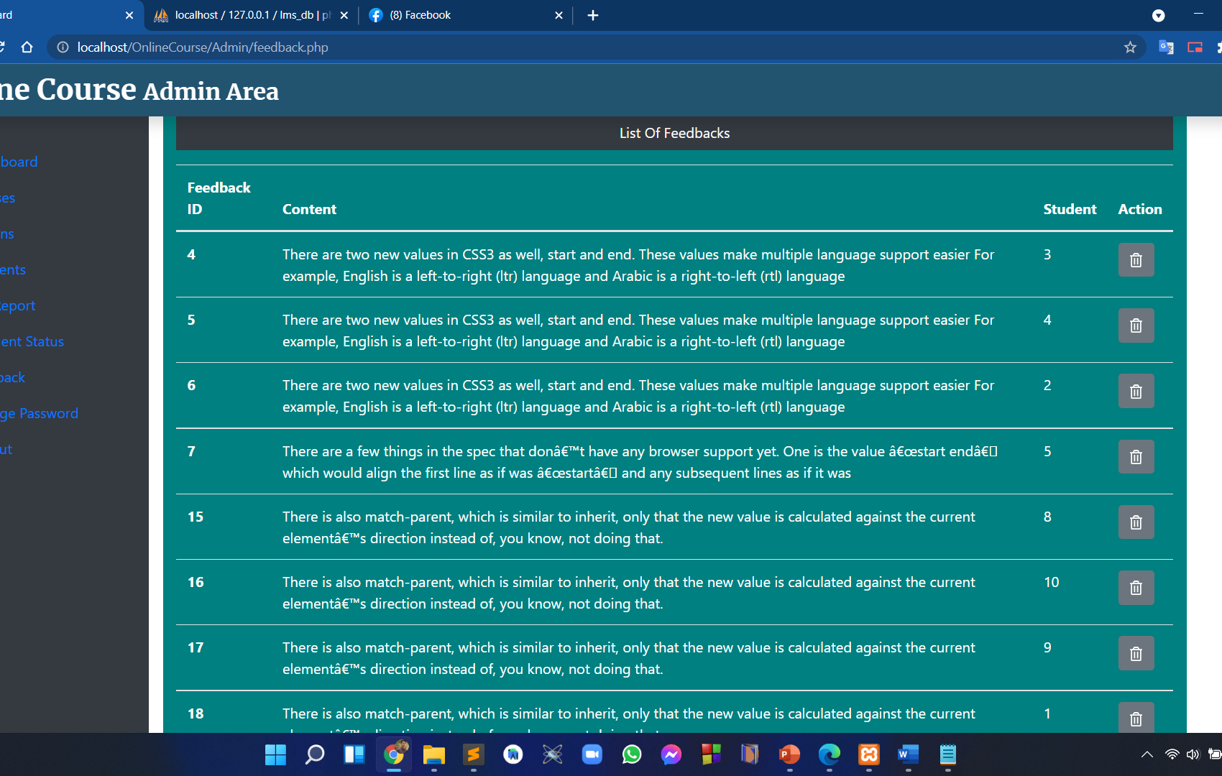
MANAGE FEEDBACK
35
Admin can delete student feedback if he want.

Slide 37
09
FUTURE WORK
36

Slide 38
FUTURE WORK
37
We will work for more features
Provide authentic CERTIFICATE
Responsive APP for android
LIVE class system by Intructor
REMOTE Exam system

Slide 39
10
REFERENCES
38

Slide 40
REFERENCES
39
Look at those references if you need
www.youtube.com
www.creately.com
www.quora.com
Logo
Template

Slide 41
THANKS!
40
Do you have any questions?
+8801764712321
admin@gmail.com

